Slide 1



Revving Up Resale: A Machine Learning Approach to Used Car Valuation.
Contributors: Alex Vallone, Dela Dadfarnia, Jyoti Mittal, Greg Knowles

Slide 2
Our Purpose:
We want to answer the following questions, using various machine learning approaches and displaying crisp visuals for our story. Here’s what we aim to answer:
What is the estimated price of a used car given its features? ML – Regression
How does depreciation affect resale value based on age/km driven? ML – Regression, Random Forest, Gradient Boosting
Which manufacturers or models offer the best power (HP/EP) to price ratio? ML – Ratio/Clustering
Which fuel types retain better value over time? Tableau

Slide 3
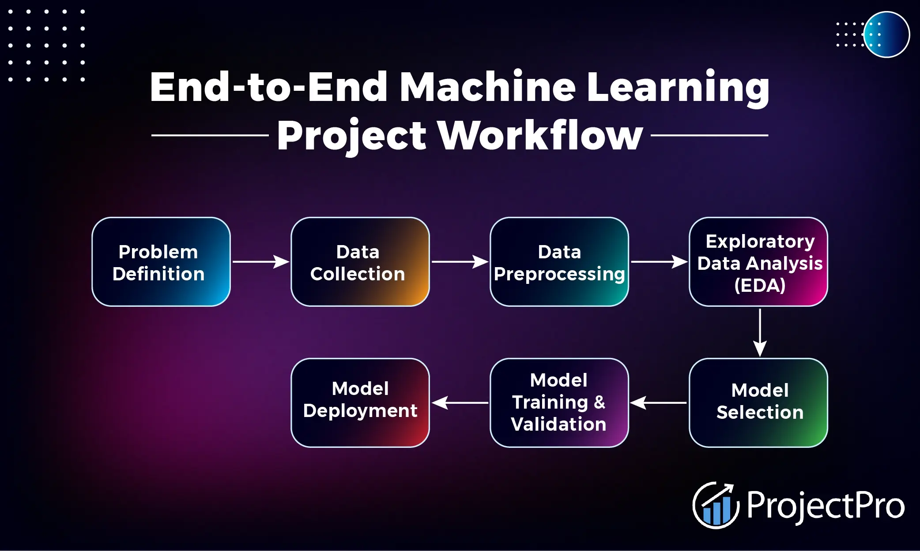
What are we looking at???

Slide 4

Question 1: What is the estimated price of a used car given its features? ML – Regression

Slide 5
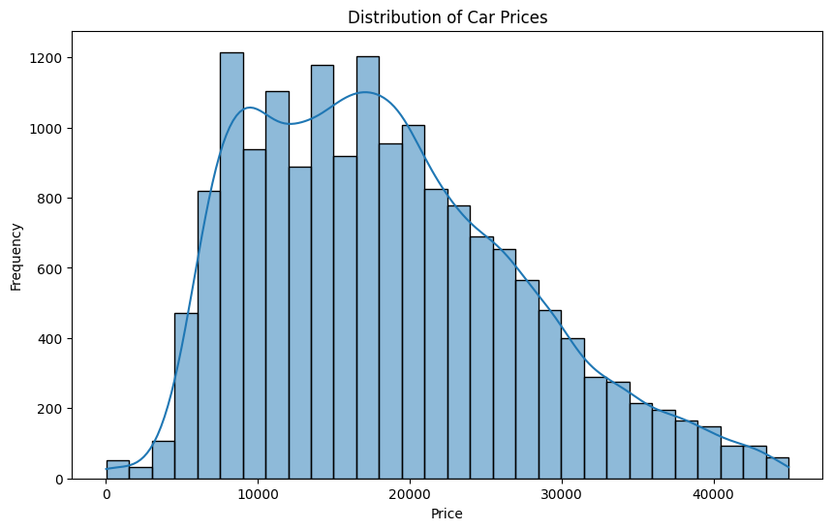
Distro of Car Prices!

Slide 6
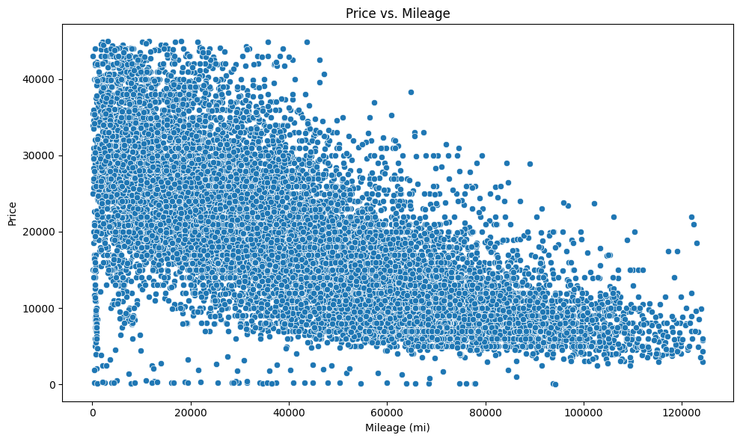
Price vs Mileage!

Slide 7

Question 2: How does depreciation affect resale value based on age/km driven? ML – Regression, Random Forest, Gradient Boosting

Slide 8
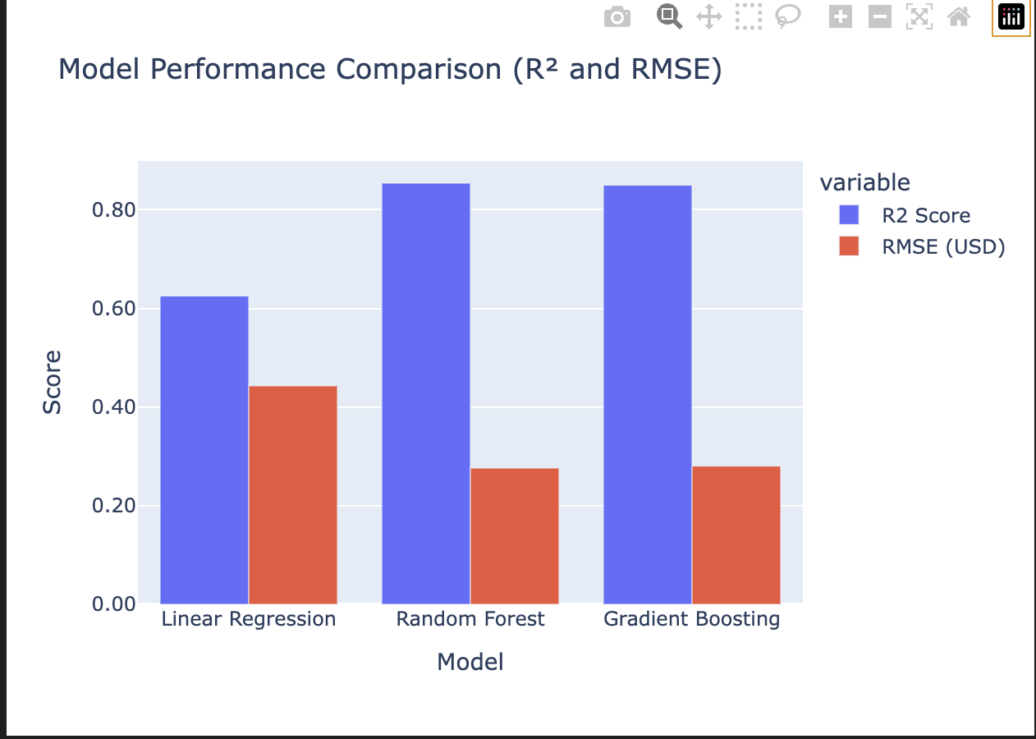
Model Accuracy:
Three regression models were evaluated to predict log-transformed resale price:
1. Linear Regression
- R²: Lower
- RMSE: Higher
- Struggled with nonlinearity
2. Gradient Boosting
- R²: Strong
- RMSE: Moderate
- Performed well on nonlinear trends
3. Random Forest Regressor (Tuned)
- 🏆 Highest R² score
- ✅ Lowest RMSE

Slide 9
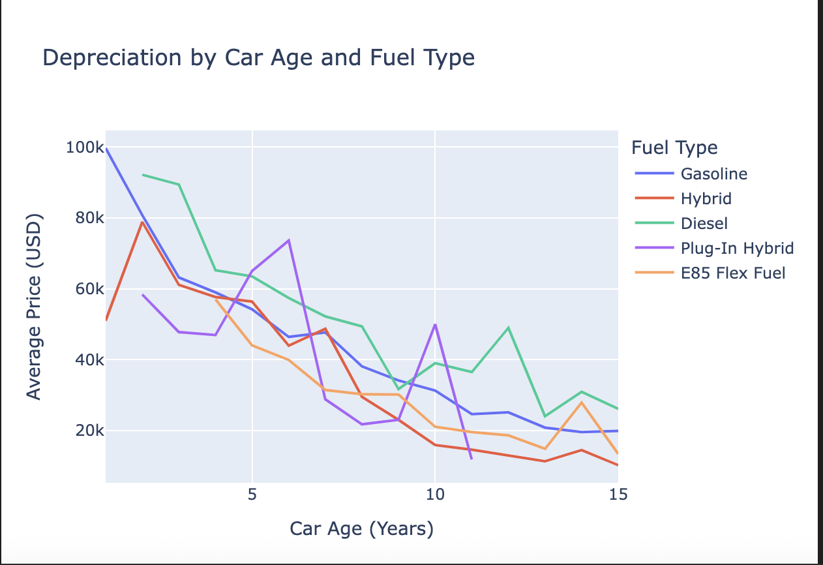
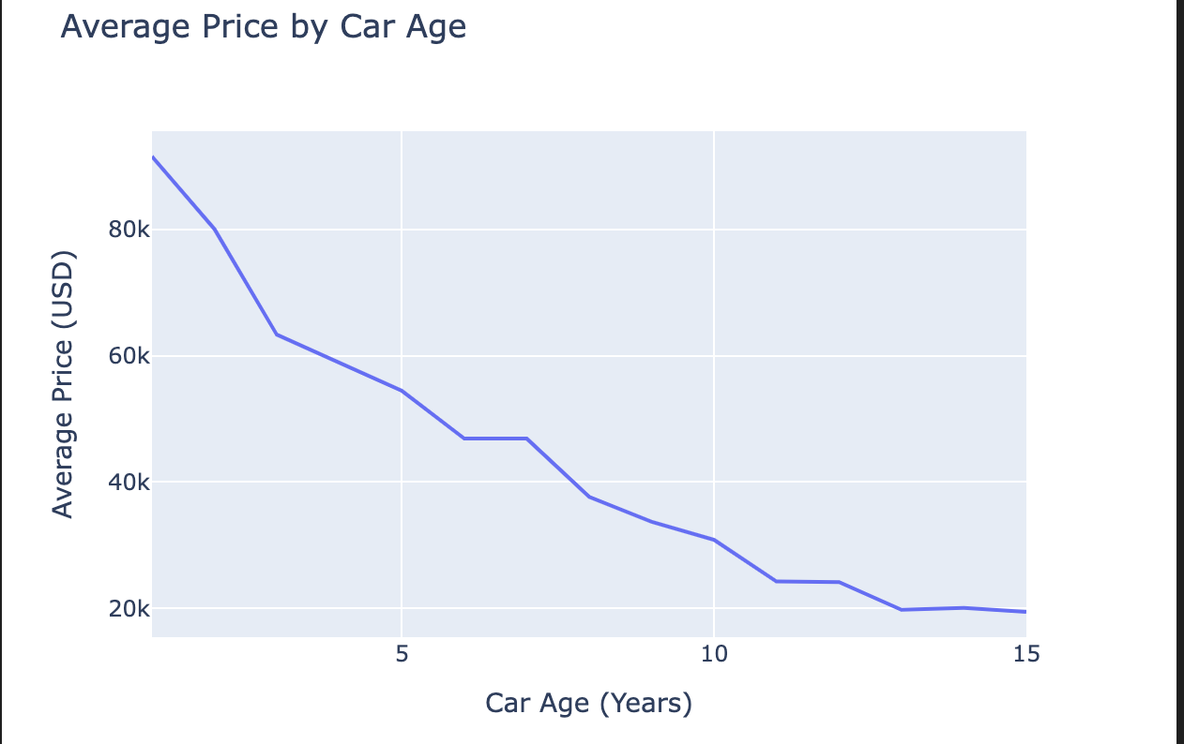
Key Questions Answered:
✔️ **How does depreciation affect resale value based on age and kilometers?**
- Price drops with age (car_age)
- Higher milage increases depreciation
- Visualized via grouped line & scatter plots
✔️ **Do fuel types depreciate differently?**
- Yes: Hybrids, Gasoline, Diesel show different curves
- Segmented line chart showed clear variance
✔️ **Can price be accurately predicted?**
- Yes — especially with Random Forest
- Nonlinear models clearly outperformed Linear Regression

Slide 10

Conclusion?
This project demonstrated a successful machine learning pipeline for used car price prediction. With two models grading at 85%!
- Engineered features like `car_age`, `engine_hp`, `milage` were key.
- Log-transform of price improved model accuracy.
- Visualizations revealed real-world pricing trends.
- Tuned Random Forest was the top-performing model.
The final model provides valuable insights into how depreciation, mileage, and fuel type influence resale value — ideal for dealers, insurers, or resale platforms.

Slide 11
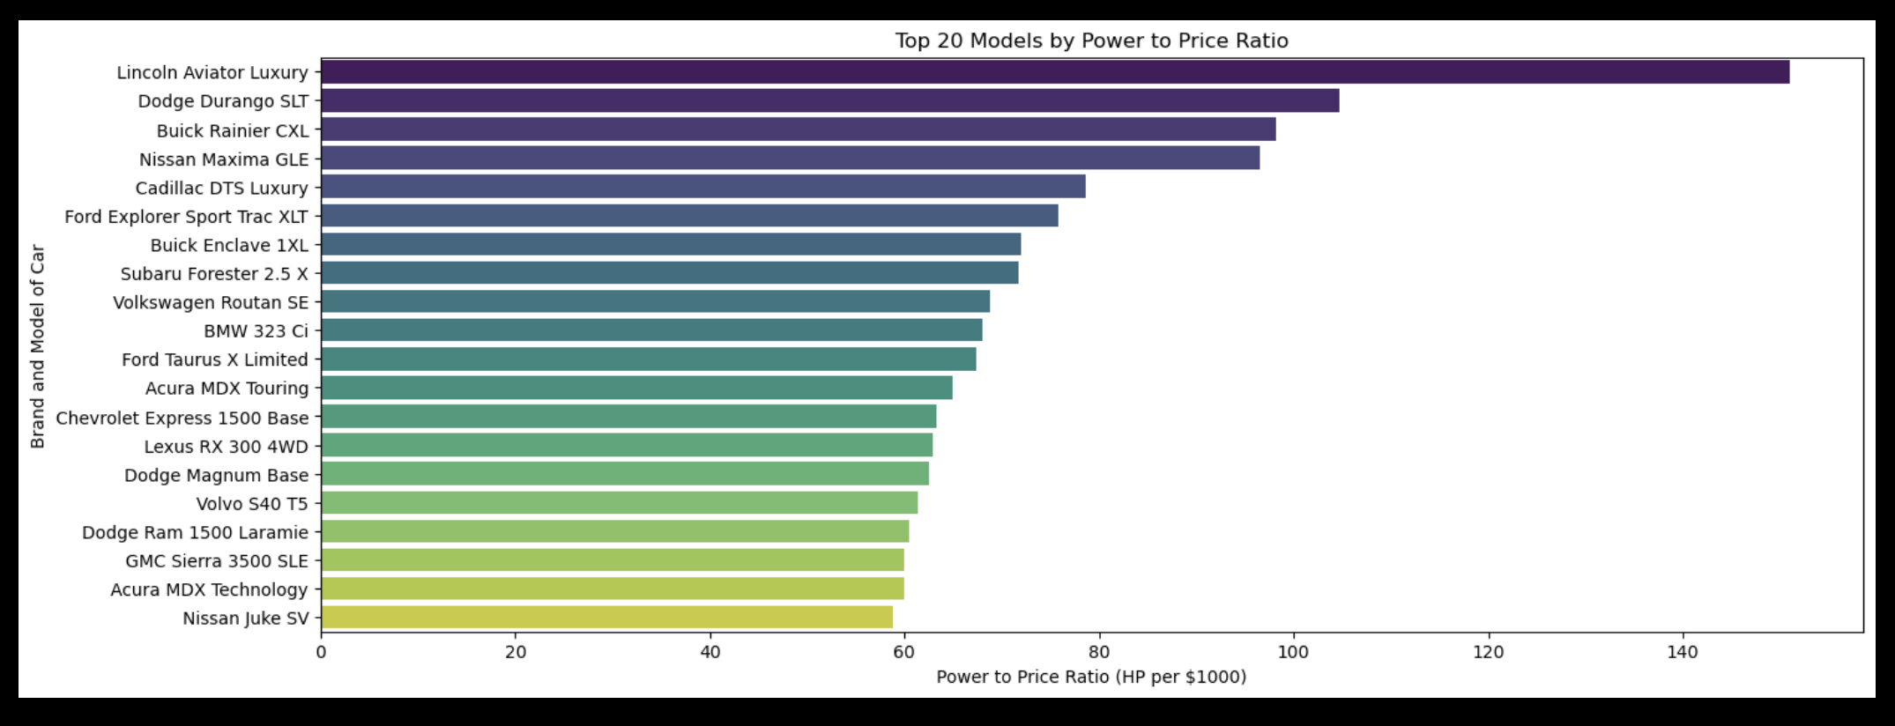
Question 3: Which manufacturers or models offer the best power (HP/EP) to price ratio? ML – Ratio/Clustering

Slide 12
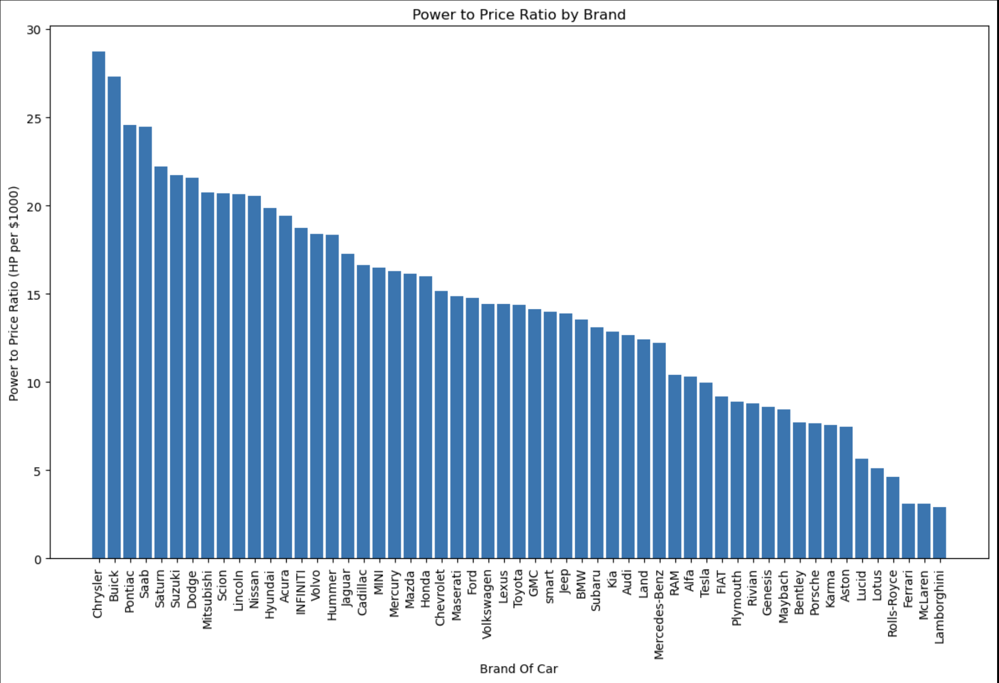
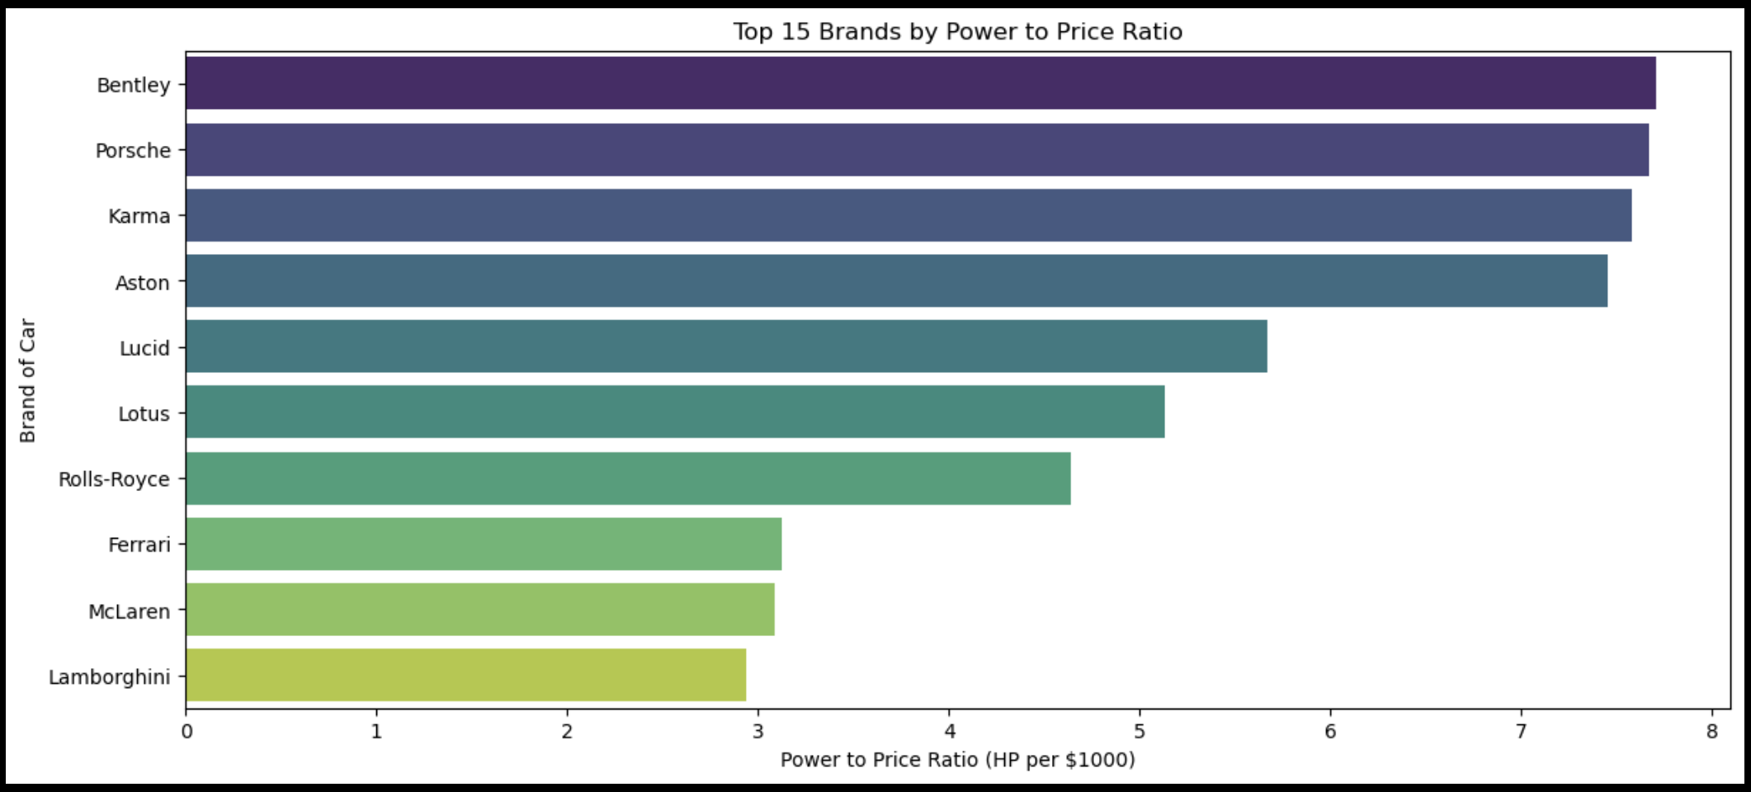
What does the power-to-price ratio reveal about luxury brands compared to others?

Slide 13
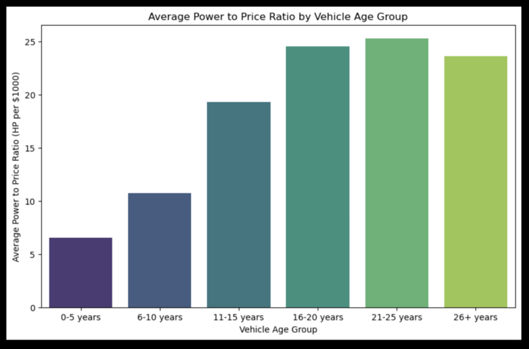
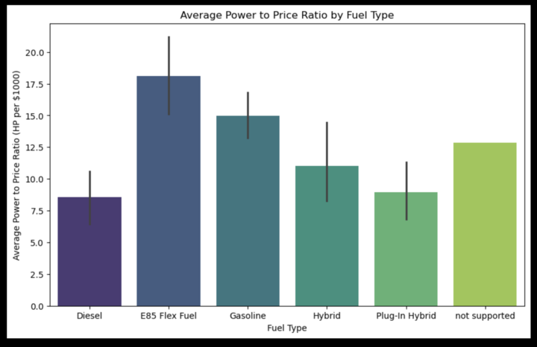
Power-to-Price by Vehicle Age
Power-to-Price by Fuel Type

Slide 14
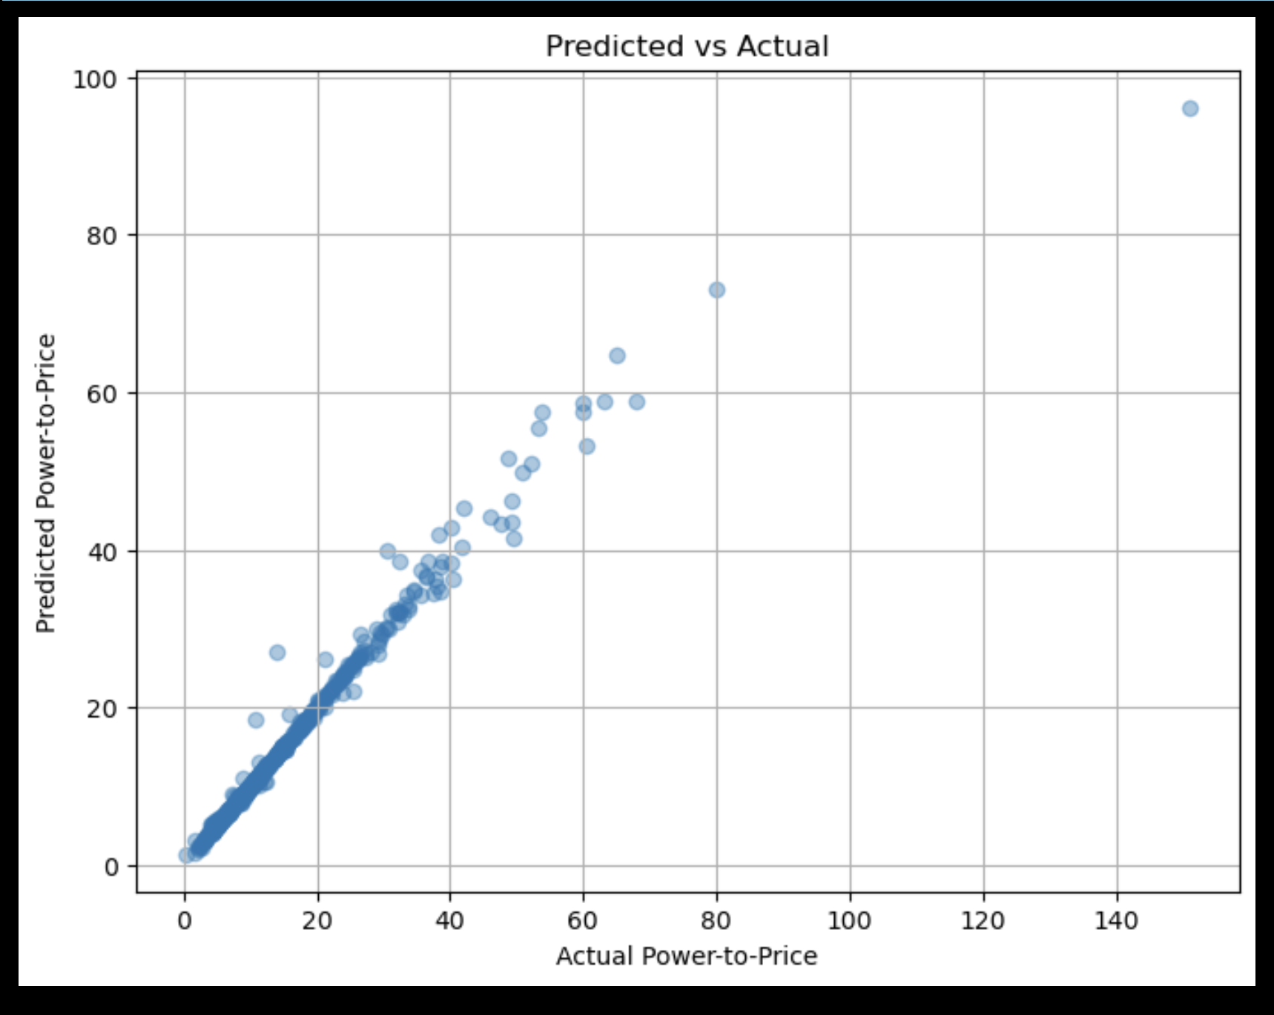
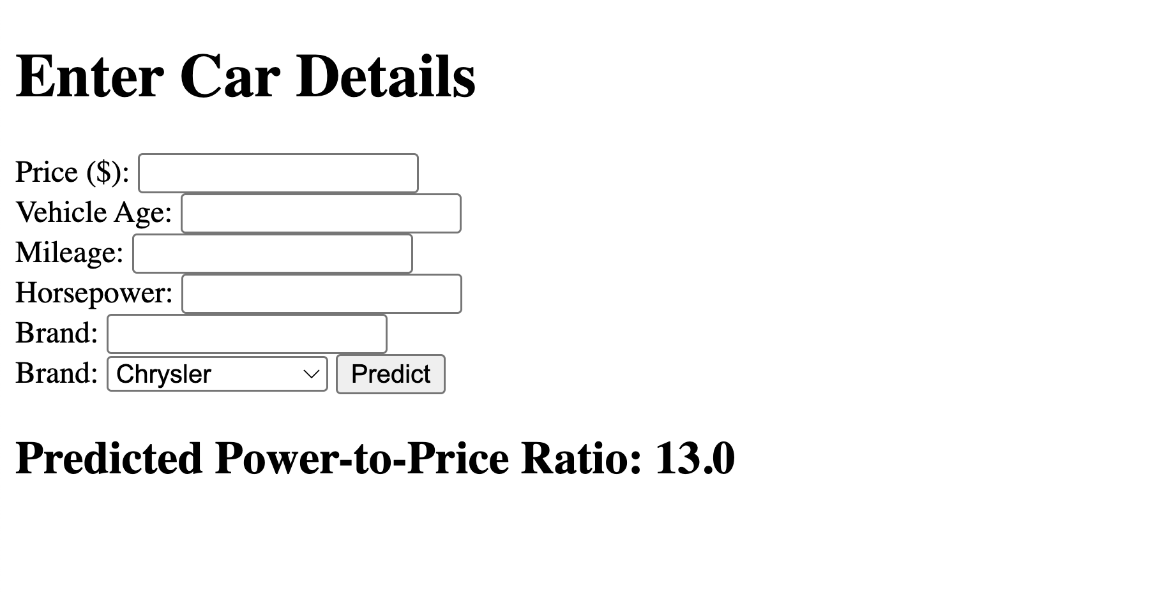
Prediction with Flask App

Slide 15
Question 4: Which fuel types retain better value over time?

Slide 16
Fuel Types
CNG (Compressed Natural Gas): primarily methane, CNG is stored in a high-pressure tank; environmentally friendly
Petrol (gasoline): liquid fuel; derived from crude oil; most common
Diesel: derived from crude oil; can be used for trucks, buses, trains, and cars

Slide 17
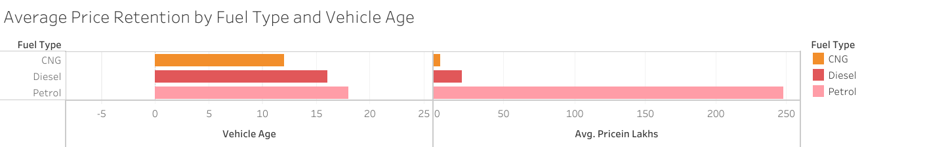
Bar Graph
Link to graph on tableau: https://utavirtdatapt-vqi5414.slack.com/files/U080LC414DC/F08RMH239S6/project_4_price_retention_viz.twbx
Petrol:
Vehicle Age: Up to 18 yrs
Avg. Price: 247.3 Lakhs
Diesel:
Vehicle Age: Up to 16 yrs
Avg. Price: 20.3 Lakhs
CNG:
Vehicle Age: Up to 12 yrs
Avg. Price: 5.2 Lakhs

Slide 18
FINDINGS:
Petrol vehicles tend to maintain a higher value over time, possibly due to being more common in the market; higher demand for this fuel type; longer lifespan.
Diesel vehicles have a much lower avg. price and shorter vehicle lifespan; these vehicles may depreciate faster or are lower in demand.
CNG has a much lower popularity compared to other fuel types; smaller market for this type of fuel.

Slide 19
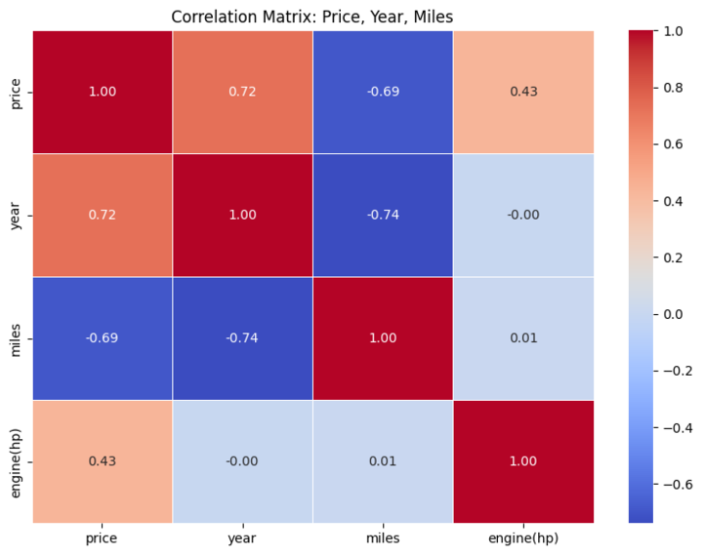

Slide 20

Final thoughts
🚘 Key Modeling Outcomes:
XGBoost achieved the best performance with 91% R² accuracy, outperforming Random Forest and Linear Regression.
Random Forest showed strong predictive power and handled nonlinearity well.
Linear Regression provided a baseline but struggled with real-world pricing complexity.
📉 Insights on Depreciation:
Age and mileage strongly reduce resale value, with depreciation accelerating after 10 years.
Fuel type matters: Petrol vehicles retain value longer than Diesel or CNG.
Mileage bins and car age segments revealed clear pricing decay trends in visual analysis.
⚙️ Power-to-Price Insight:
Non-luxury brands offer better horsepower per dollar, especially in 4–12-year-old cars.
Luxury brands have higher resale prices, but lower power efficiency.
🧠 What We Answered:
✅ How depreciation impacts price over time and mileage
✅ Which fuel types retain more value
✅ Which brands offer the best performance-to-price ratios
✅ Whether resale prices can be accurately predicted from features (Yes — 91% accuracy)
🌐 Final Deliverable:
A full-stack Flask web app enabling:
Real-time resale prediction
Power-to-price analysis
Interactive dashboards for buyers and analysts

